Slide 1
Help Me Help You
Lessons from the Incident Response Frontlines

Slide 2
Who Am I?
United States Marine Corps (Reserve)
0311 Rifleman (2004-2012)
Fallujah, Iraq (2006-2007)
Law Enforcement (Sworn)
Patrol (2012-2016)
Detective (2016-2019)
Law Enforcement (Civilian)
HHS OIG (2019-2020)
Incident Response (IR)
Kroll – Senior Vice President (2020-2024)
Unit 42 (PANW) – Senior Consultant (2024-Present)
Education
Bachelor’s – CJ/Sociology (2006-2011)
Master’s – HR Admin (2013-2015)
Side Projects
Digital Forensics Discord Server (2018-Present)
GitHub Enthusiast (2020-Present)
DFIR Tools, Scripting, Books
Family
Wife
2 kids (son/daughter)
4 cats
1 dog

Slide 3
Let’s Level Set First
What I am:
Incident responder
Digital forensics examiner
What I am not:
An IT professional
What I never have been:
A Sysadmin
What I have never done:
Configured Active Directory
Provisioned devices for users
Scope:
Windows (cloud or on-prem)
Particularly, the OS partition, but also…
NTFS-formatted data partitions
Target audience:
IT professionals
Sysadmins
Anyone else who has influence over the configuration of end user Windows devices

Slide 4
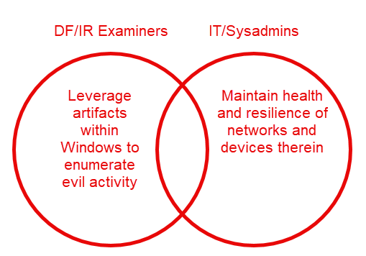
Key Questions and Objectives
2 main questions (examiner)
Does the artifact exist?
Does it cover the timeframe of interest?
2 main objectives (sysadmin)
Ensure the most helpful forensic artifacts exist
Ensure the most helpful forensic artifacts cover the timeframe of interest
Prevention is ideal, but detection is a must

Slide 5
Key Terminology
Evil.exe – Generic name for malicious binary dropped by a threat actor, typically data exfil tool renamed (ex: 1.exe, scvhost.exe), ransomware binary, or even an everyday Sysadmin tool used for malicious purposes
Evil.bat | Evil.ps1 – Generic name for malicious script(s) dropped by a threat actor, typically to automate defeating AV, establishing persistence, recon for files of interest to exfil, etc.
Triage – The process of examining 1-2% of the files on disk that provide answers to 95% of the questions during an IR engagement
Live Response – Analyzing volatile system and user artifacts from a live system (memory, running processes, active network connections, etc.)
Deadbox Forensics – Analyzing system and user artifacts from an offline copy of a live system (E01, VMDK, VHD, etc.)

Slide 6
Disclaimer
Everything I’m sharing here has been proven to help incident responders provide better answers POST-incident
The intent is not to cover proactive measures, although some of these certainly can help with that
The intent of this talk is to ensure the impacted evidence turned over to the IR firm is as valuable as it can be to help us help you!
Beyond what this talk covers, there are an overabundance of guides and best practices to implement proactive measures, and I highly encourage those…
…but we’re looking at the following topics through the lens of deadbox forensics/triage
“Prevention is ideal, but detection is a must”

Slide 7
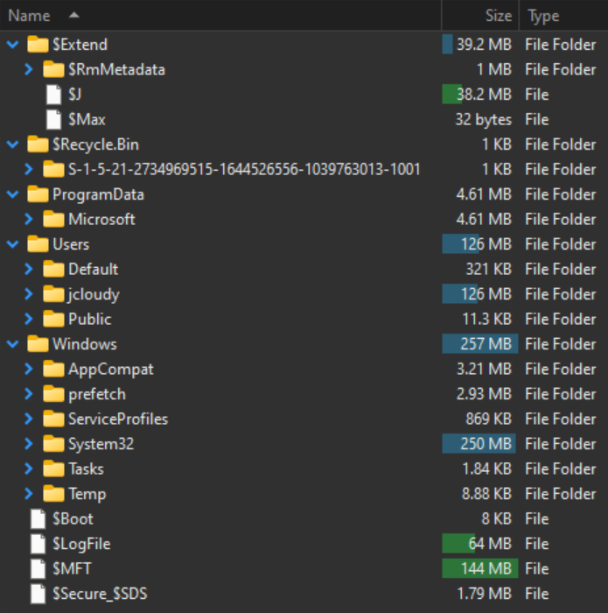
Triage – Windows Forensics
Event Logs (.evtx)
Recycle Bin
$I/$R
User artifacts
AppData\Local
AppData\Roaming
Execution artifacts
Prefetch/Amcache/UserAssist
Registry Hives (and transaction logs)
User (NtUser/UsrClass)
System (SAM/SECURITY/SOFTWARE/SYSTEM)
SRUM/SUM
NTFS Metadata Files
$MFT/$J/$LogFile

Slide 8
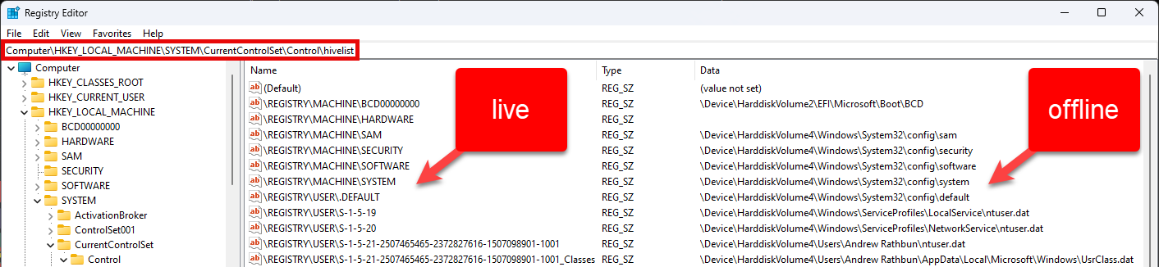
Live vs Offline Artifacts
An example of how the same artifact can take different forms depending on live vs offline interaction
Example: HKLM/HKCU, etc., don’t exist in my world

Slide 9
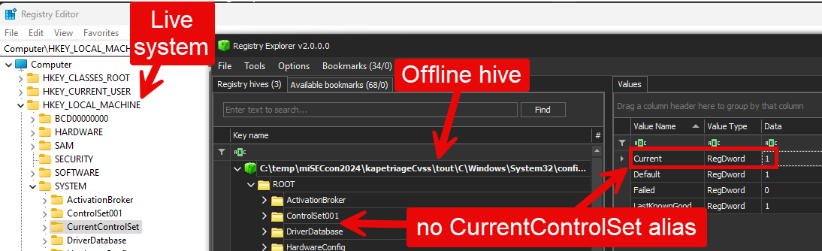
Live vs Offline Artifacts
Another example of how the same artifact can take different forms depending on live vs offline interaction
Example: CurrentControlSet serves as an alias in the registry

Slide 10
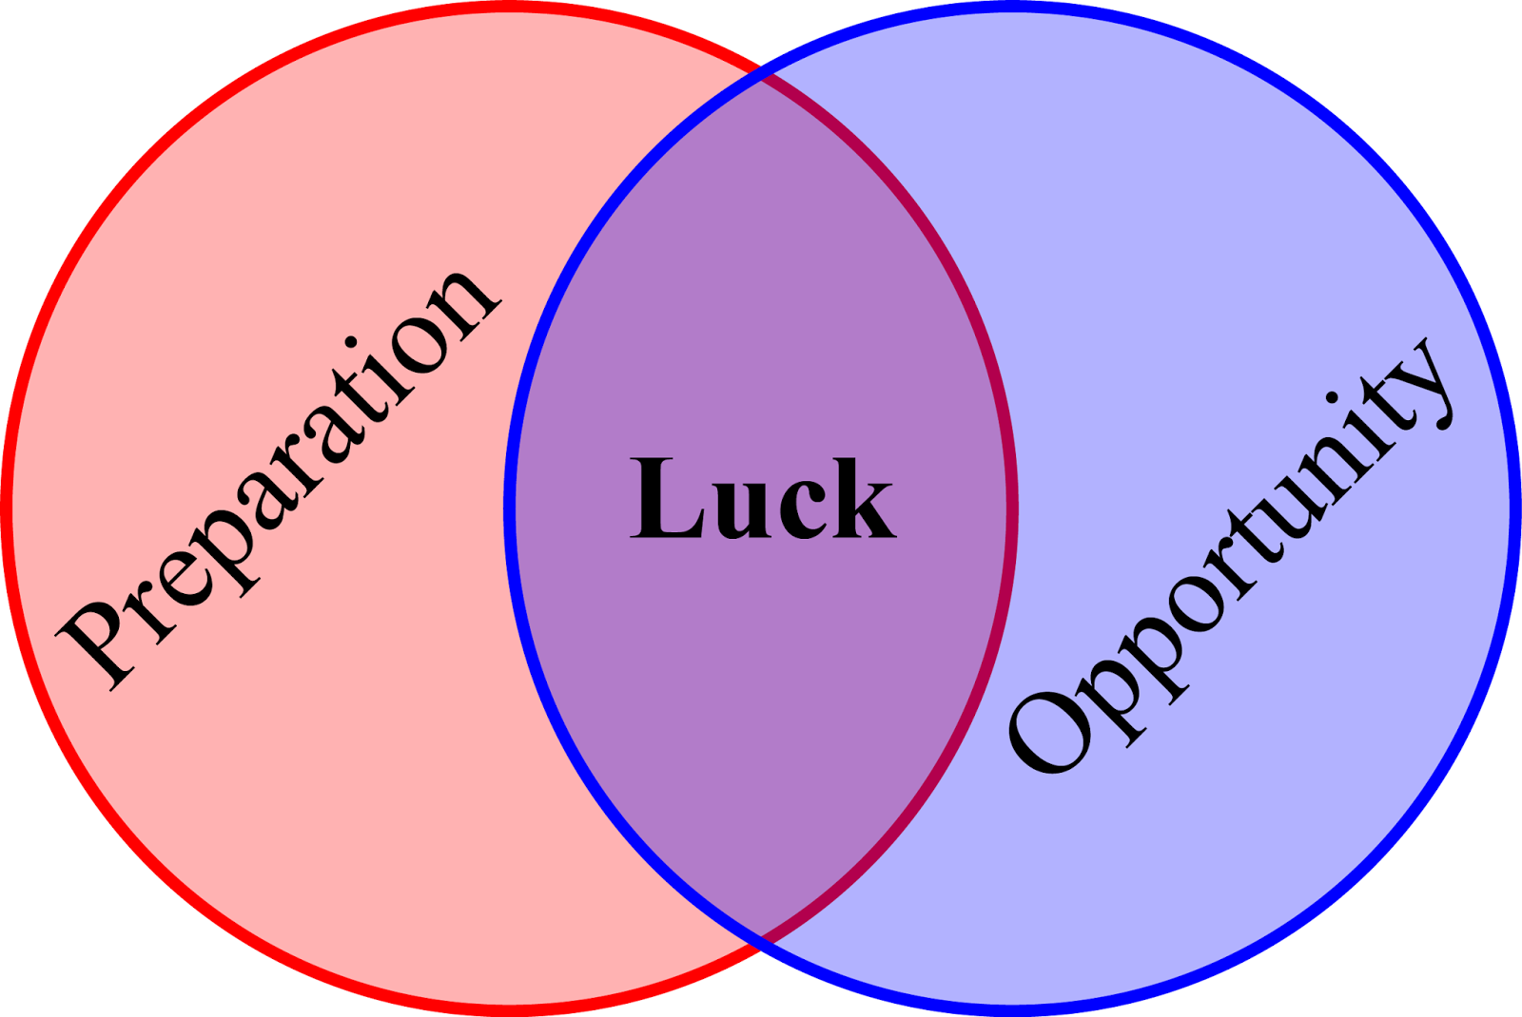

Slide 11
Call to Action
Evil can occur within your network, but if you haven’t put controls in place to capture the full totality of the evil, it’ll be much harder for an IR team to report on the full impact to your organization
Cost-benefit analysis: disk space vs answers for WHEN, not if, a cyber security incident occurs
“If it’s not written down it didn’t happen”
Think of these recommendations as helping the endpoints in your network “write it down”

Slide 12
1. Increase Event Log Size
Log rollover is a very common problem for a variety of reasons
Default log sizes on busy endpoints (mostly domain controllers)
Lag in engaging with IR firm (weeks after incident)
Systems restored from backup before IR firms get hands-on (this is fine but retain the infected backup please!)
Increase the size of the Security log, if nothing else
Event Viewer -> Right-click -> Properties (next slide)
Group Policy for changing at scale

Slide 13
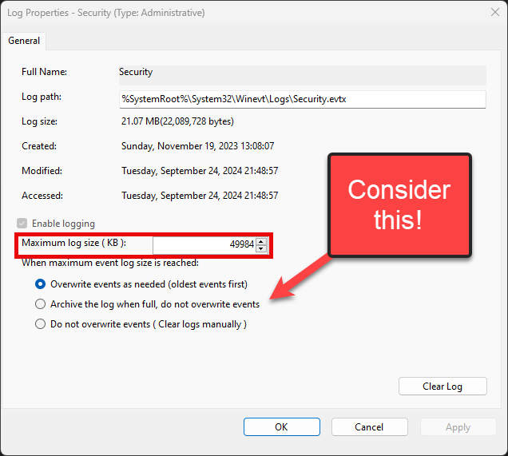
Default Event Log Size (Security)
49984 = 50000 (must be multiple of 64)
Hesitant? Here’s the middle-ground approach
Don’t increase log size, but turn on archiving… (example in next slide)
Archive-Security-2024-10-12-15-44-31-175.evtx
…or enable log forwarding!

Slide 14
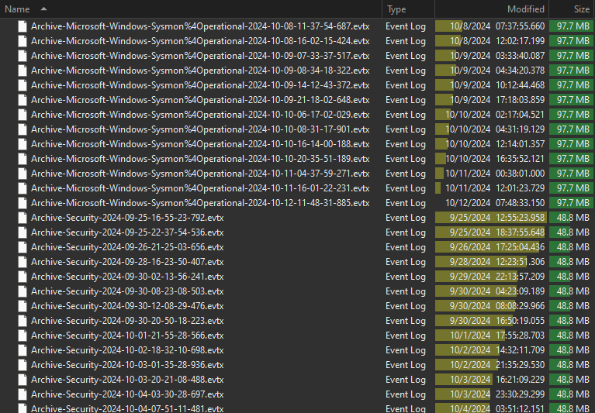
Event Log Archiving

Slide 15
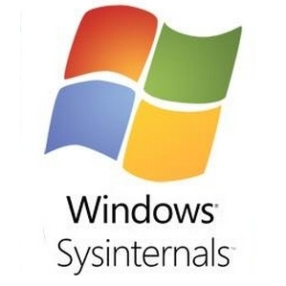
2. Sysmon
Free tool from Microsoft
Records many events catered for attacker TTPs
NOISY, but would rather have it and not need it than need it and not have it
Can be configured, check GitHub for various configs, but vanilla is better than nothing!
Once enabled, please increase the size!
If you don’t pay for an EDR, there’s no excuse not to enable this. Use it even if you do have EDR!

Slide 16
Sysmon Events (Part 1)
EventID | Description | Comment
1 | Process creation | Similar to Security:4688
2 | A process changed a file creation time | Detects timestomping
3 | Network connection | Source/dest IP address and ports
4 | Sysmon service state changed | Detects TA removing Sysmon
5 | Process terminated | Similar to Security:4689
6 | Driver loaded | Detects potential vulnerable drivers
7 | Image loaded | Detects modules loaded into processes
8 | CreateRemoteThread | Process creates thread in another
9 | RawAccessRead | Detects potential exfiltration of locked files (raw disk read bypasses Windows API)
10 | ProcessAccess | Detects Mimikatz and similar

Slide 17
Sysmon Events (Part 2)
EventID | Description | Comment
11 | FileCreate | Logs file creations/overwrites
12 | RegistryEvent (Object create and delete)
13 | RegistryEvent (Value Set)
14 | RegistryEvent (Key and Value Rename)
15 | FileCreateStreamHash | Malware via browser downloads
16 | ServiceConfigurationChange
17 | PipeEvent (Pipe Created) | Detects malware using named pipes for interprocess communication
18 | PipeEvent (Pipe Connected) | Detects when a named pipe connection occurs between client and server

Slide 18
Sysmon Events (Part 3)
EventID | Description | Comment
19 | WmiEvent (WmiEventFilter activity detected) | Detects use of WMI by malware
20 | WmiEvent (WmiEventConsumer activity detected) | Detects use of WMI by malware
21 | WmiEvent (WmiEventConsumerToFilter activity detected) | Detects use of WMI by malware
22 | DNSEvent (DNS query) | Records all DNS activity
23 | FileDelete (File Delete archived) | Detects file deletions, saves copy
24 | ClipboardChange (New content in the clipboard) | Detects clipboard changes (exfil)
25 | ProcessTampering (Process image change) | Detects process hollowing
26 | FileDeleteDetected (File Delete logged) | Detects file deletions, no copy
27 | FileBlockExecutable | Detects/blocks EXE file creations
28 | FileBlockShredding | Detects File Shredders (SDelete)
29 | FileExecutableDetected | Detects new EXE files

Slide 19
Sysmon Wrap-Up
Updating Sysmon
First, you must uninstall
Sysmon64.exe –u
Next, install the updated version of Sysmon
Sysmon64.exe –accepteula –I
Can be customized to reduce noise/increase fidelity
Many popular XML configs are on GitHub (Example: SwiftOnSecurity)
Not mandatory to customize
Refer to many blog posts for guidance
Default is better than nothing!

Slide 20

If you don’t want to install Sysmon…
Can you at least….

Slide 21
3. Enable Security:4688 Events
Also known as Process Tracking/Creation and Command-Line Auditing
Mirrors functionality of Sysmon:1 – Process Creation
Supported on Windows 7 and newer
Location: Computer Configuration > Policies > Windows Settings > Security Settings > Advanced Audit Configuration > Detailed Tracking
Should be voluminous, so a larger Security log will be necessary to reduce rollover of potentially critical events
If you don’t pay for an EDR, there’s no excuse not to enable this (IMO)

Slide 22
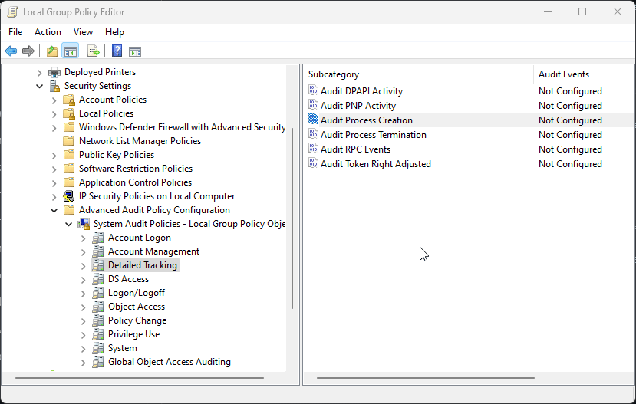

Slide 23
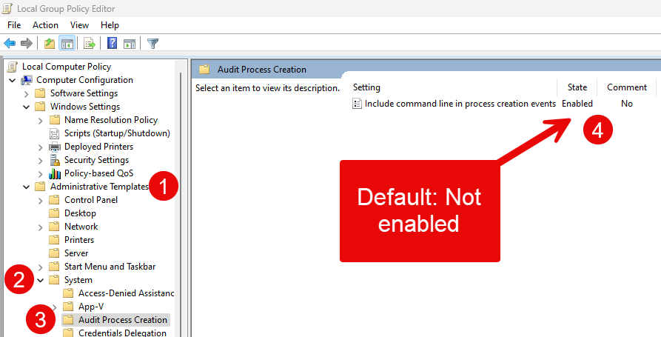

Slide 24
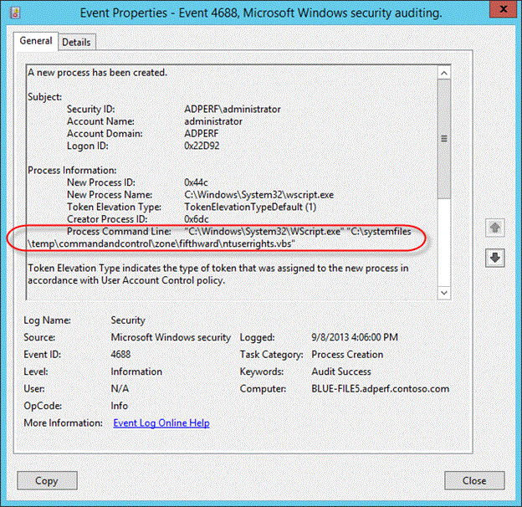

Slide 25
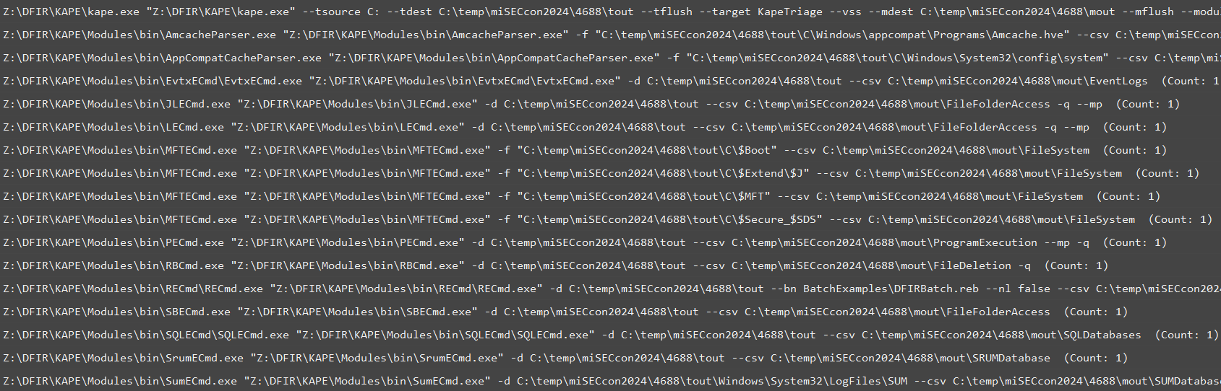
Example of 4688s generated for this presentation

Slide 26
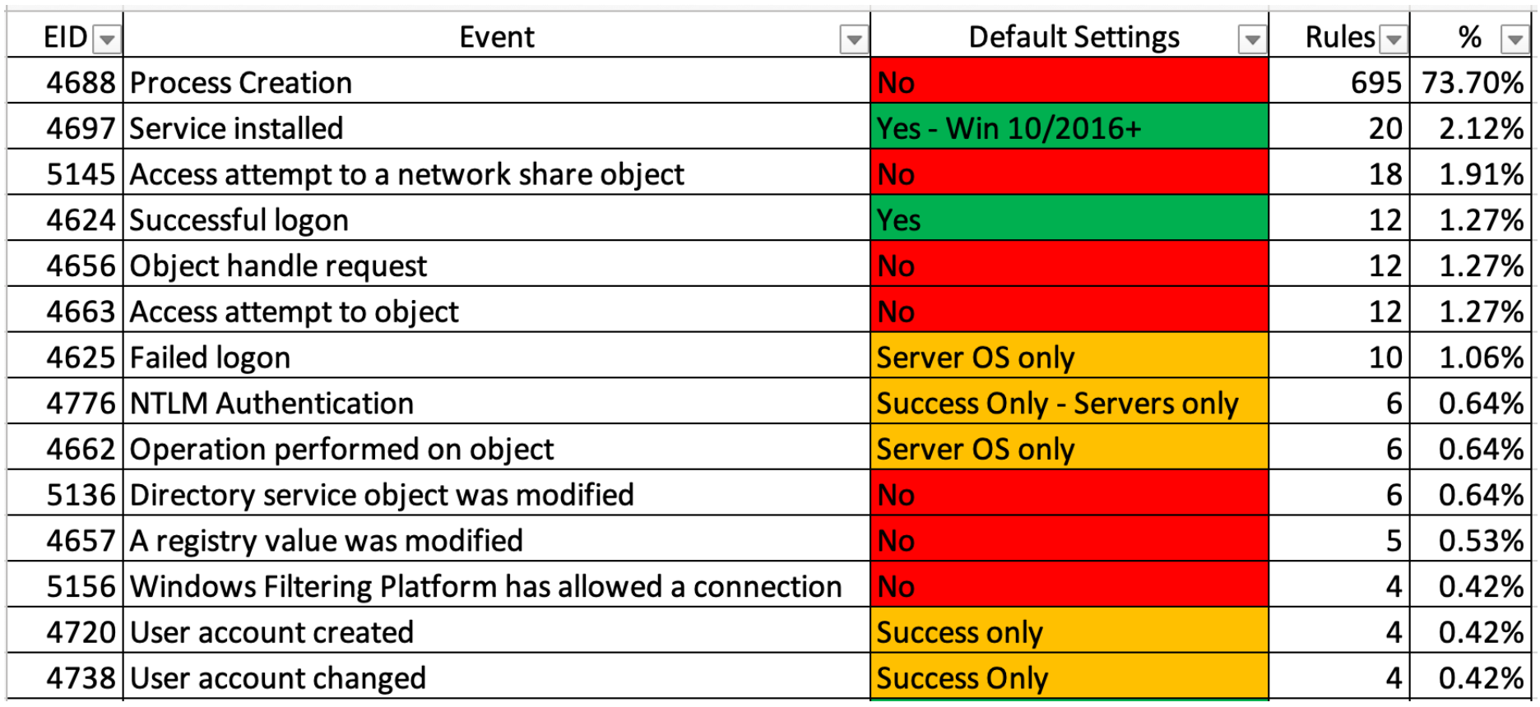
Coverage of 4688s in Sigma Rules
Current as of 2022
Credit: Yamamoto-Security/EnableWindowsLogSettings (GitHub)
TL;DR: 4688s (or equivalent) are invaluable for leveraging the latest CTI/research

Slide 27
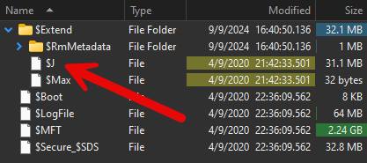
4. USN Journal
NTFS metafile
Also known as: UsnJrnl, UsnJrnl:$J, $J
Managed with fsutil on a live system
Records a play-by-play of every file created, deleted, extended, truncated, etc.
Not always on by default, and default allocation is small: 32mb
Small = only a few hours of file system activity vs. days or weeks
Important considering lag in engagement with IR firms. Every minute data is being lost
Critical in keeping track of files deleted from file system (hint: threat actors do this a lot)

Slide 28
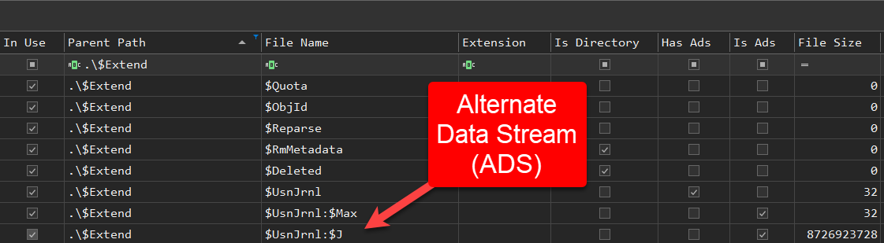
$J located in $MFT
^ MFTECmd used to process C:\$MFT and generate CSV output ^
Located at C:\$Extend\$UsnJrnl:$J
$J is an Alternate Data Stream of $UsnJrnl

Slide 29
Watching $J in action
Next slides will show multiple examples of live file system activity:
A file and folder being created, with live entries being generated and tailed using fsutil
That same file and folder being deleted, with live entries being generated and tailed using fsutil

Slide 30
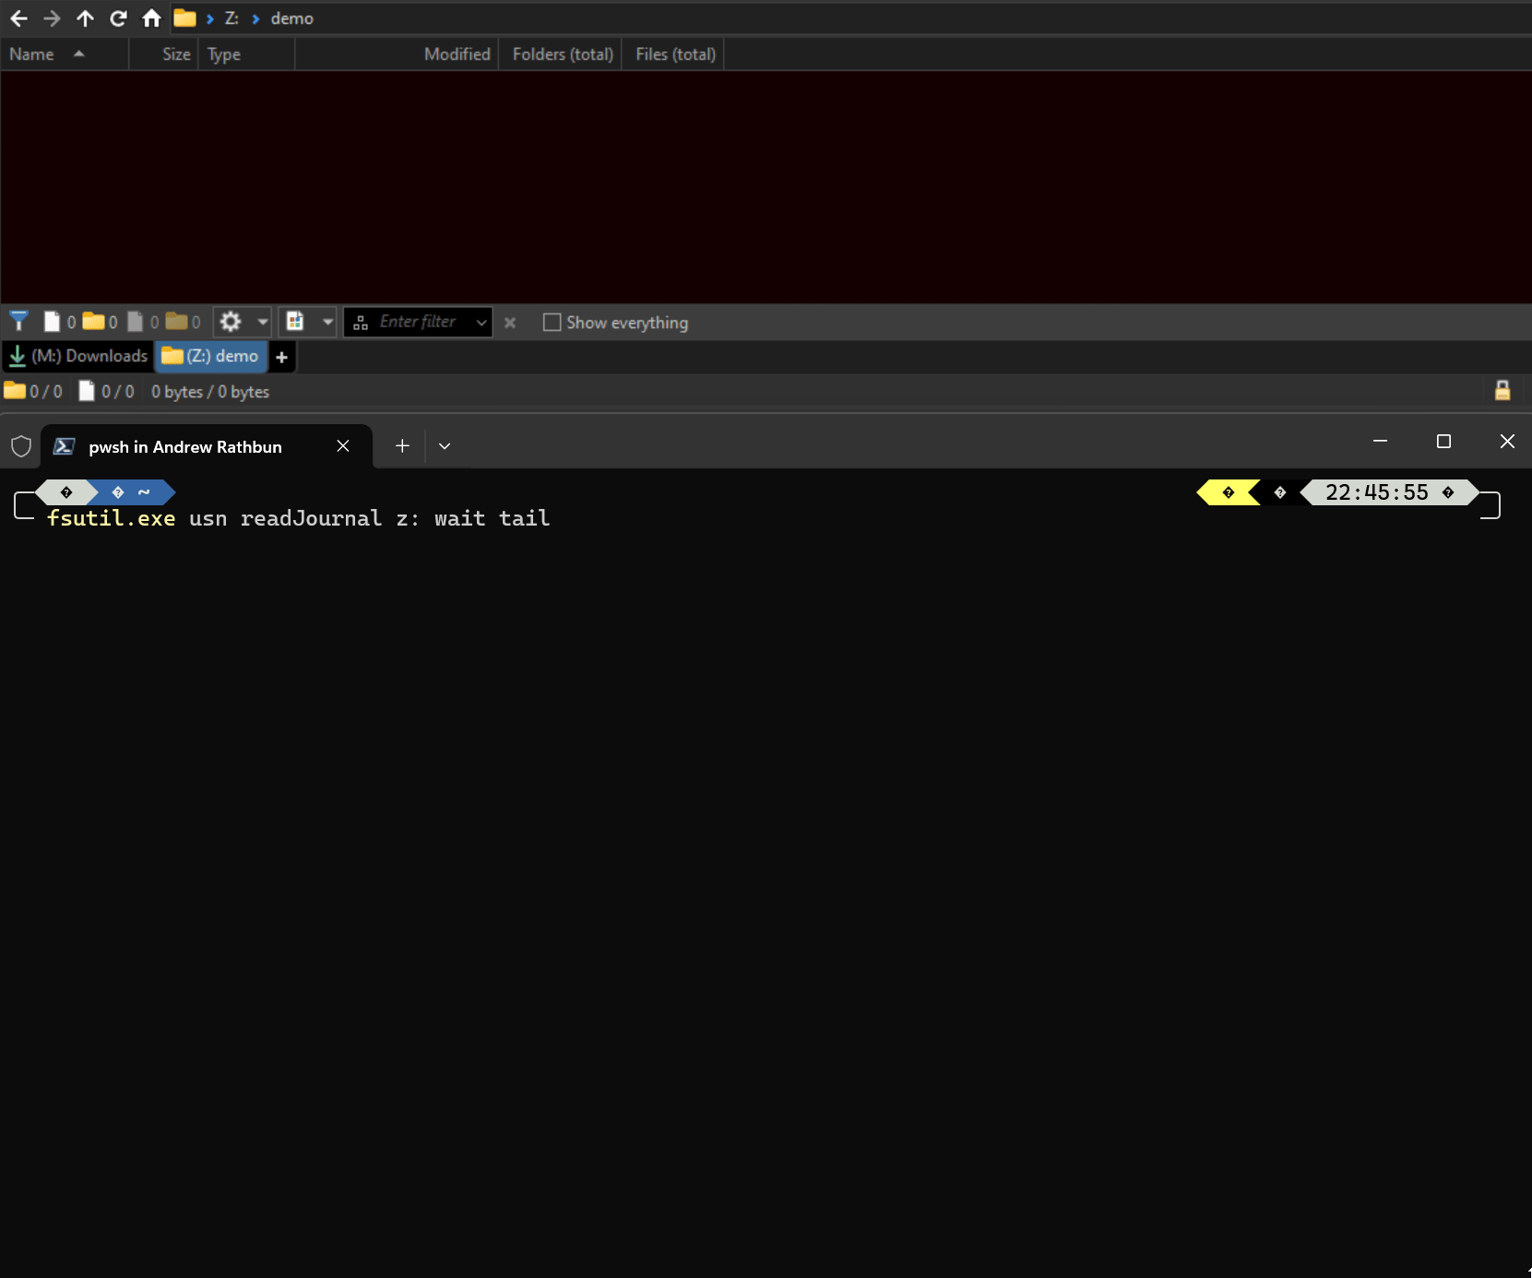

Slide 31
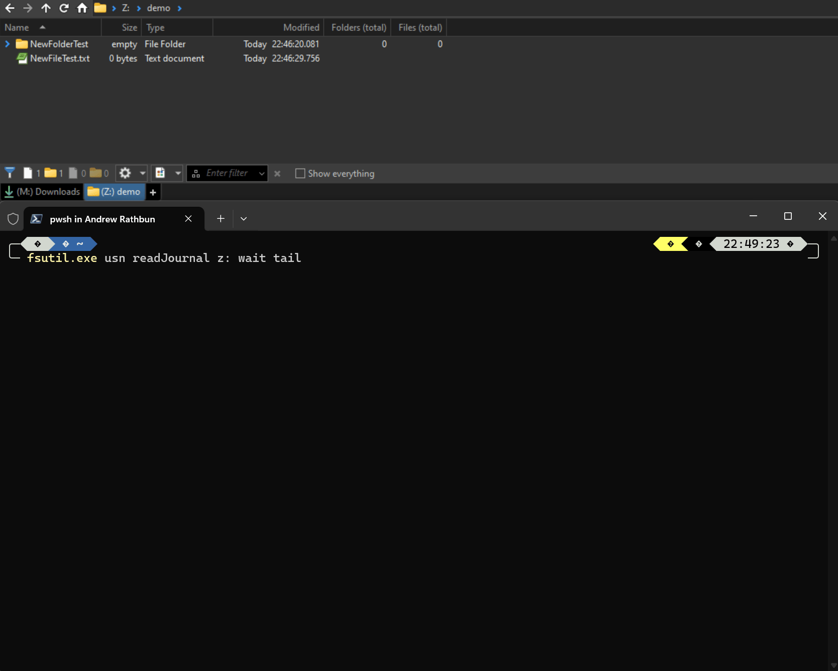

Slide 32
Importance of File System Monitoring
Imagine how useful months of similar file system activity would be to help answer questions about what a threat actor did within your network
The next slide contains what I would look at if I were investigating an endpoint where this same scenario occurred
CSV output generated from MFTECmd ingested into Timeline Explorer
MFTECmd processes NTFS metadata artifacts, including $MFT and $J

Slide 33
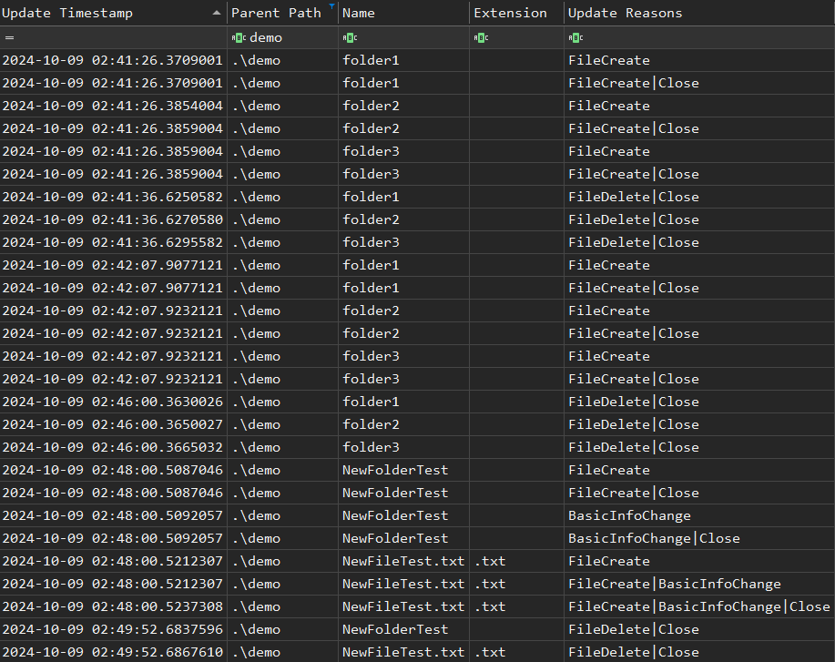

Slide 34
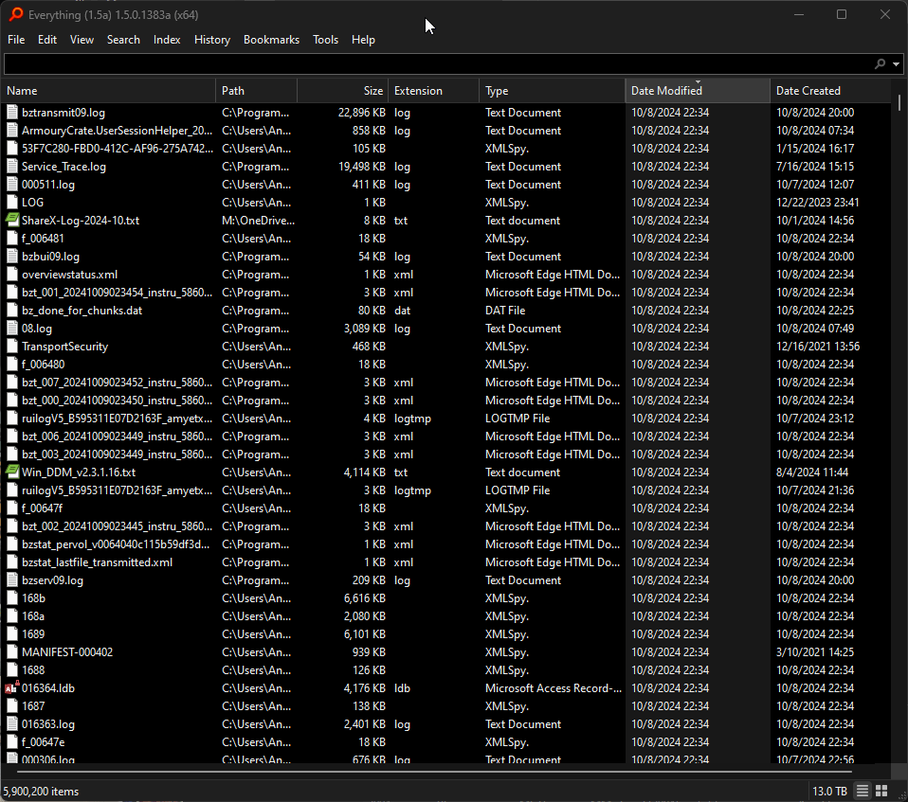
Tools like Everything by VoidTools can be used to search and monitor file system activity
I prefer the Alpha version because of Dark Mode and more advanced features

Slide 35
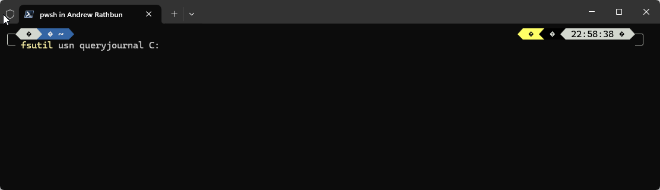
Checking $J Status
fsutil usn queryjournal C:
fsutil usn createjournal m=2147483648 C:
fsutil usn queryjournal C:

Slide 36
5. SRUM (System Resource Usage Monitor)
Stores data found in Task Manager/Resource Monitor
Useful for evidence of execution and network activity (BytesSent/BytesReceived)
Requires the Diagnostic Policy Service to be running!
ESE Database that records every minute to RAM, every hour (59-61ish minutes) to disk (C:\Windows\System32\sru\SRUDB.dat), contains 90 days of data
Workstations
AppResourceInfo – Records what applications were running (evidence of execution)
NetworkUsages – Records bytes sent/bytes received by applications (data exfil)
Server
Different tables, not as forensically relevant at this time. Needs more research!

Slide 37
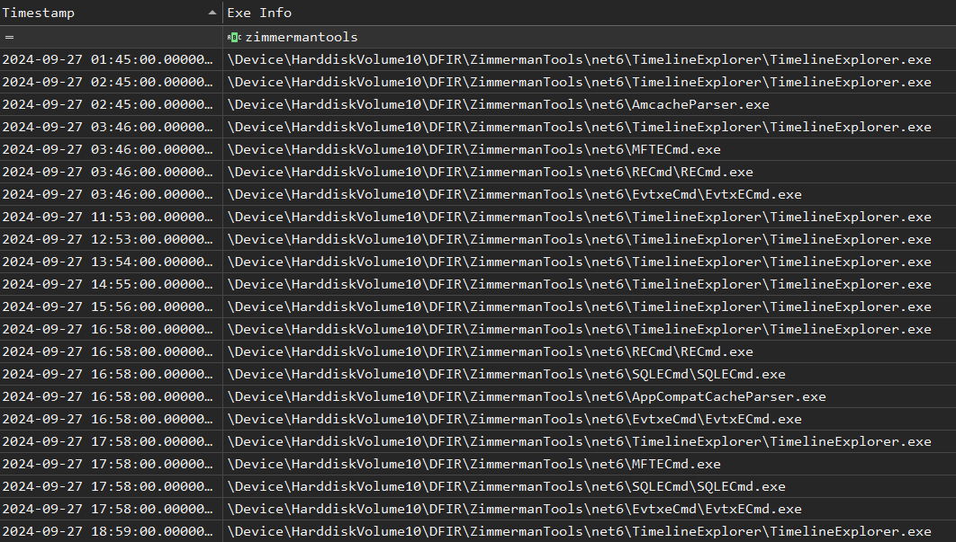
SRUM (AppResourceInfo)

Slide 38
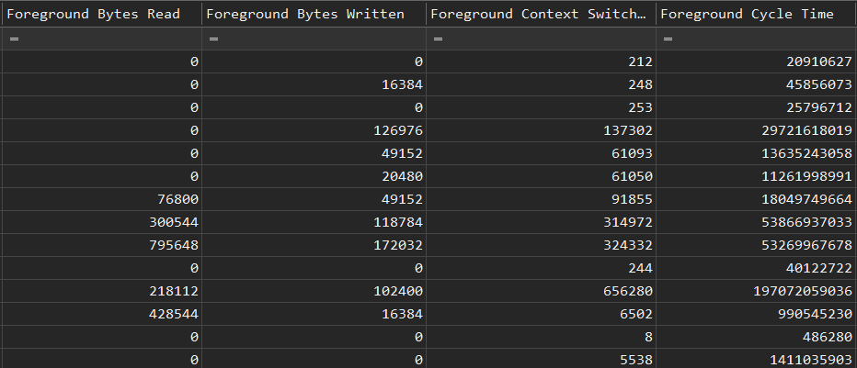
SRUM (AppResourceInfo)

Slide 39
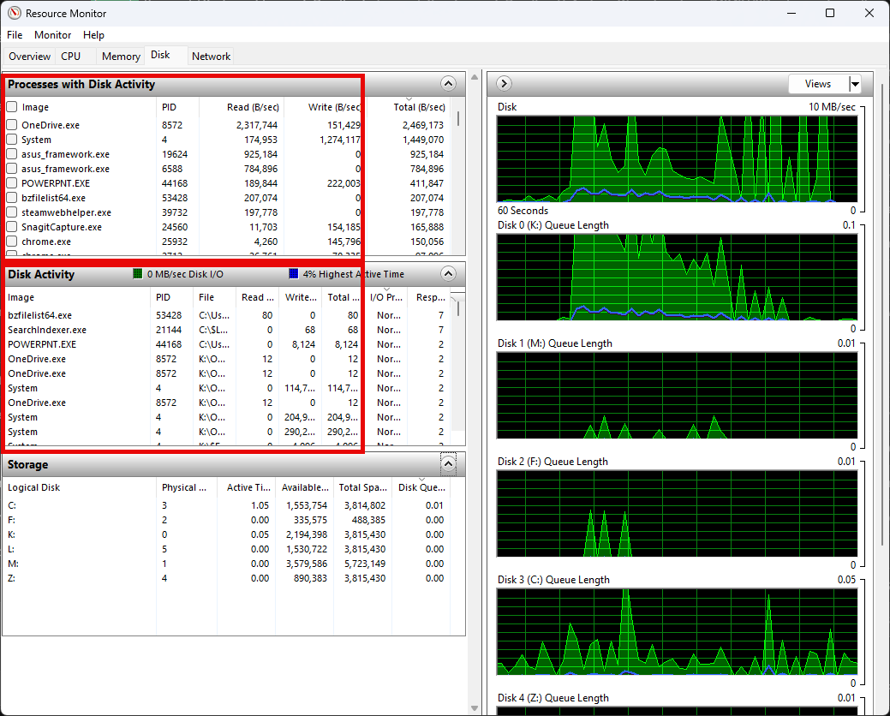

Slide 40
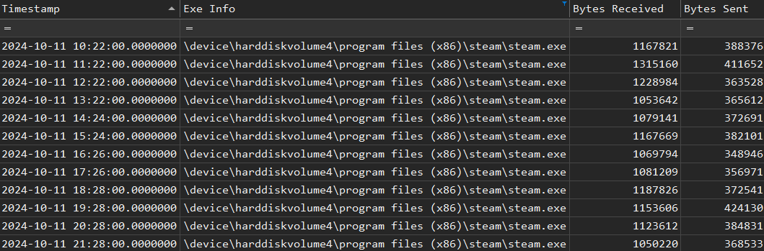
SRUM (NetworkUsages)

Slide 41
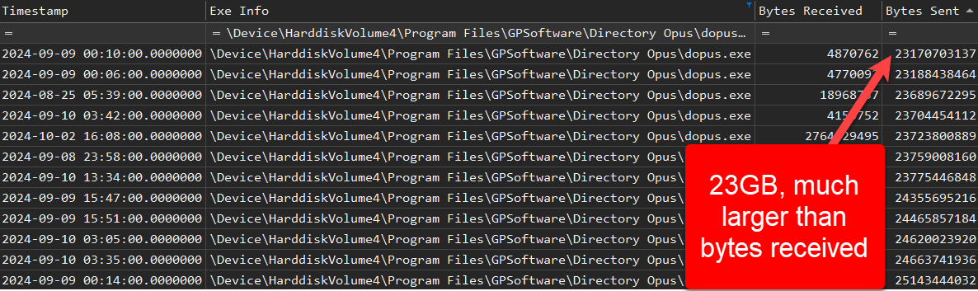
SRUM (NetworkUsages)
Example of what data exfiltration could look like by a process
This is Directory Opus likely copying files onto my NAS

Slide 42
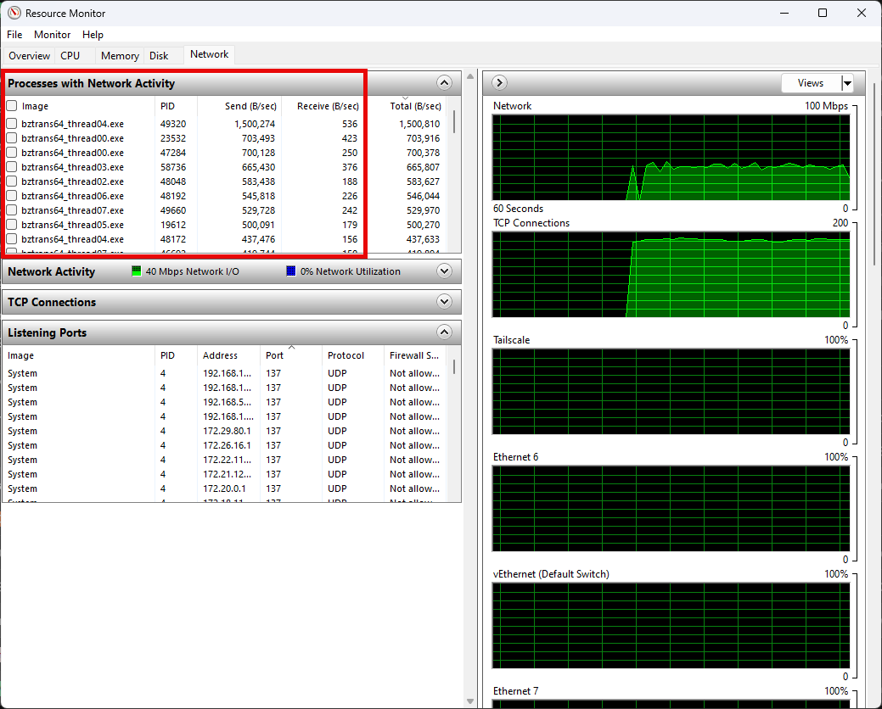

Slide 43
6. Volume Shadow Copies (VSCs)
Volume Shadow Copy Service (VSS) has been around since Windows XP
System Restore and Windows Server Backup rely on this
Goal: have more than zero Volume Shadow Copies when you provide a forensic image (E01) of a host of interest
vssadmin resize shadowstorage /For=C: /On=C: /MaxSize=20%

Slide 44
VssAdmin
VssAdmin is a LOLBIN
Living Off the Land BINary
Signed by Microsoft
Ships with Windows
BONUS: LOLBAS (binaries, scripts, libraries)
W11 24H2 (clean install)
~941 executables
~5591 DLL files
Example commands
vssadmin create shadow
Creates a new shadow copy
vssadmin delete shadows
Deletes shadow copies
Common anti-forensics TTP
vssadmin resize shadowstorage
Changes the maximum size of the shadow copy storage area

Slide 45
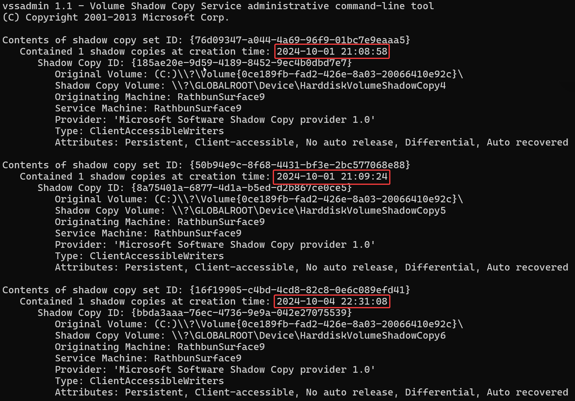
VssAdmin list shadows

Slide 46
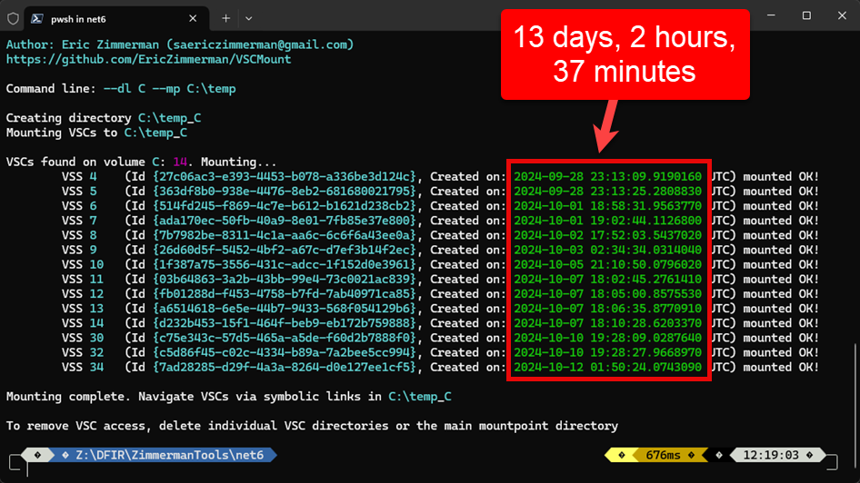
VscMount

Slide 47
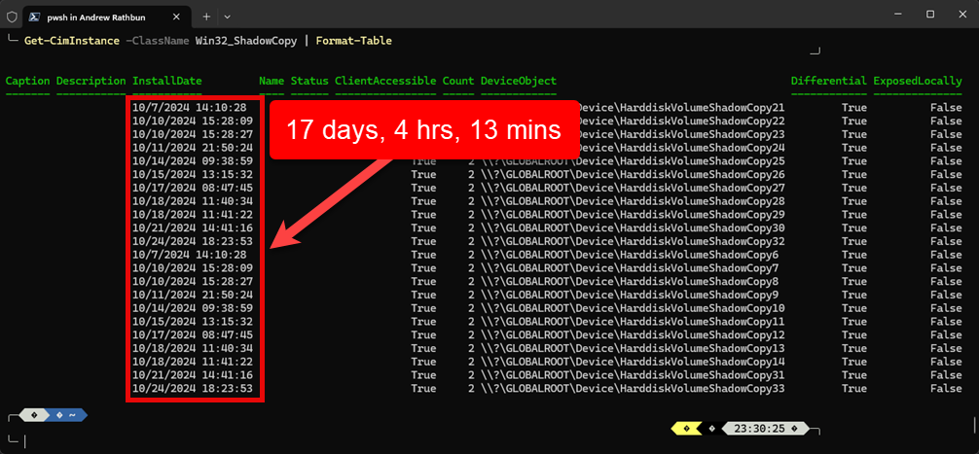
WMI via PowerShell
Get-CimInstance -ClassName Win32_ShadowCopy | Format-Table

Slide 48

7. Scheduled Task Triage Backups
KAPE is a free* tool created by Eric Zimmerman that is ideal for triage acquisition of important Windows artifacts
GUI and CLI
Customizable and fast!
KAPE Official Demo for more info
*For internal, research, and any other non-paid engagement scenarios

Slide 49
Triage – Windows Forensics (again!)
Event Logs (.evtx)
Recycle Bin
$I/$R
User artifacts
AppData\Local
AppData\Roaming
Execution artifacts
Prefetch/Amcache/UserAssist
Registry Hives (and transaction logs)
User (NtUser/UsrClass)
System (SAM/SECURITY/SOFTWARE/SYSTEM)
SRUM/SUM
NTFS Metadata Files
$MFT/$J/$LogFile

Slide 50
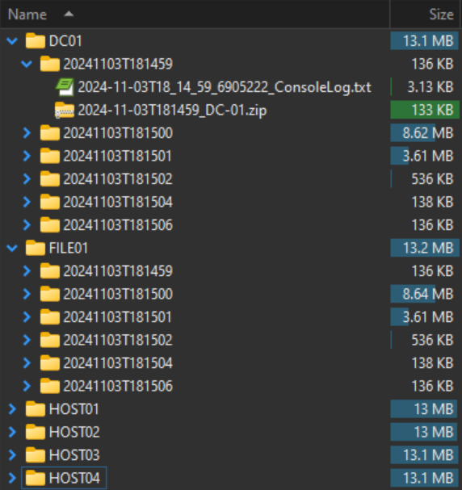
An alternative/step up from archiving event logs
Store ZIP files either on each host somewhere (tdest) or orchestrate a centralized collection point (S3, SFTP, Azure)
One command network wide
%m = hostname
%d = timestamp
Scheduled task (weekly) to run the following command:
.\kape.exe --tsource C: --tdest C:\backups\%m\%d --target KapeTriage --vhdx %m --debug

Slide 51
A Case Study
High fidelity host (HOST01) – lots of important plot points occurred on this host (data exfil, lateral movement, anti-forensics, ransomware deployment)
Disclaimer: This is a reenacted scenario from a case worked almost 2 years ago. This is a best effort reenactment, so timestamps in screenshots of log files or artifacts may not always be congruent with each other.

Slide 52
A Case Study – Setting the Scenario
Compromised account (domain admin) RDPs into HOST01
Downloads and runs AnyDesk (doesn’t need to be installed) as a backdoor
Drops evil.exe, and uses evil.ps1 to execute evil.exe
$J was present and huge (covered approximately 6 months of file system activity)
Multiple VSCs (~15) present on the forensic image (E01) provided by client

Slide 53
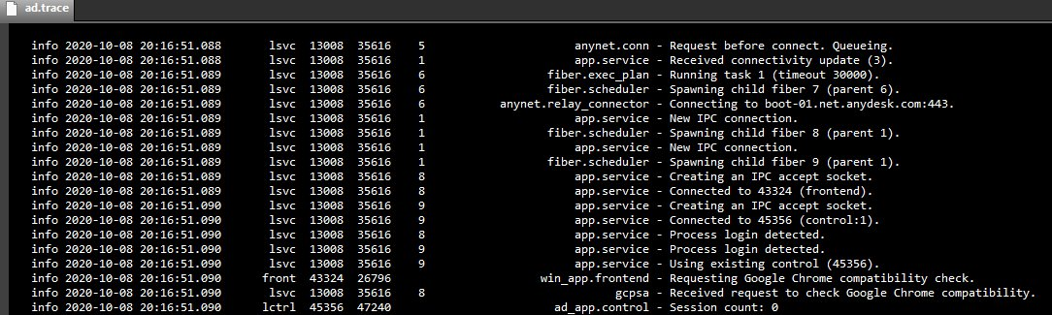
AnyDesk ad.trace modified by TA
ad.trace is a log file that tracks AnyDesk user session activity
No header observed at the top of the file to indicate a new AnyDesk session

Slide 54
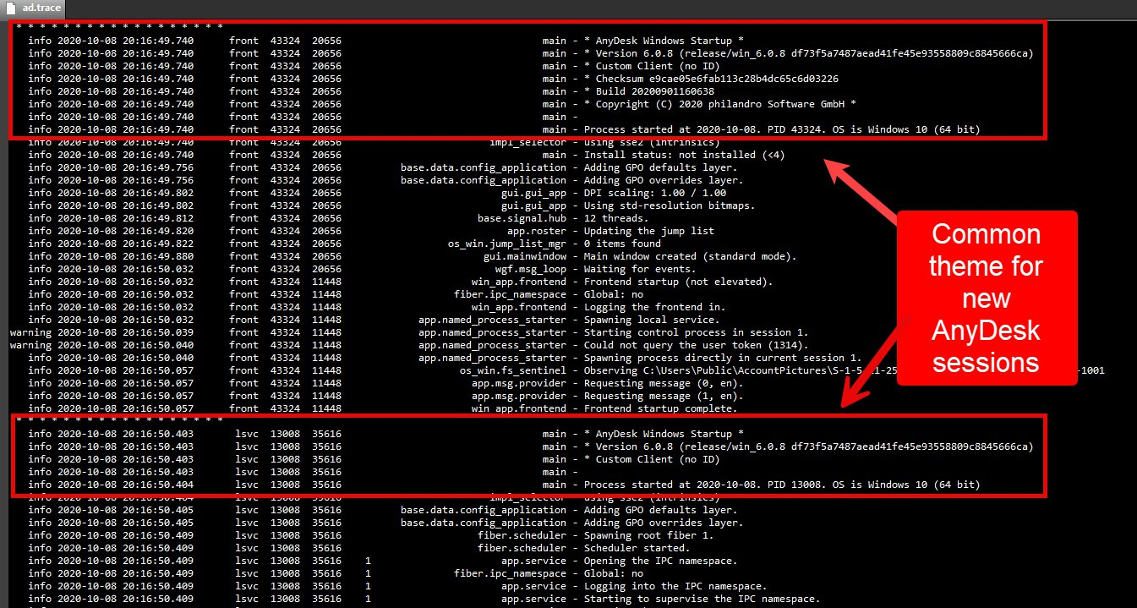

Slide 55
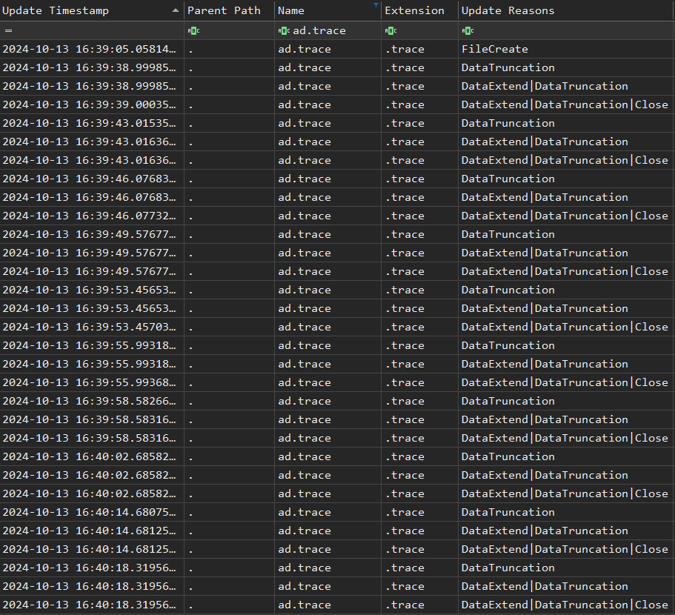
UsnJrnl:$J

Slide 56
Summary of Host Timeline
16:08:12 | HOST01 | DOMAIN\admin | RDP Connect
16:11:45 | HOST01 | DOMAIN\admin | File Download - AnyDesk
16:12:02 | HOST01 | DOMAIN\admin | Program Execution - AnyDesk
16:12:33 | HOST01 | Files Created - evil.exe & evil.ps1
16:13:11 | HOST01 | Files Executed - evil.exe & evil.ps1
16:39:56 | HOST01 | DOMAIN\admin | Outbound RDP to multiple hosts
18:03:14 | HOST01 | DOMAIN\admin | RDP Disconnect
18:04:27 | HOST01 | $J – DataTruncate | AnyDesk – ad.trace
18:04:45 | HOST01 | $J – DataTruncate | AnyDesk – ad.trace

Slide 57
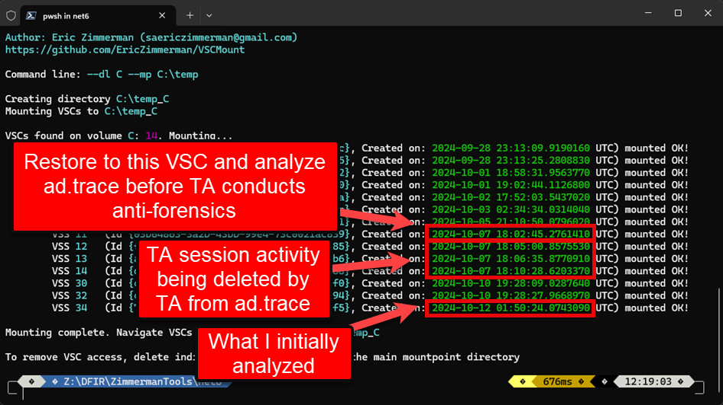

Slide 58
Bonus: Data Exfil Observations
On another case, there was no evidence of MegaSync artifacts at the time of analysis, but $J showed the following files with multiple DataExtend events:
megaclient_statecache13_transfers_eE50cXJsZkl3czRbMll6s7JXeCfKeEwq.db
megaclient_statecache13_transfers_eE50cXJsZkl3czRbMll6s7JXeCfKeEwq.db-shm
megaclient_statecache13_transfers_eE50cXJsZkl3czRbMll6s7JXeCfKeEwq.db-wal
No other evidence relating to data exfil was present, but it’s reasonable to assume that at those times of DataExtend, transfers were occurring with the MegaSync client (also confirmed with testing)
These DB files are always being deleted and re-created during MegaSync transfers, which makes having a large $J invaluable to IR teams

Slide 59
Summary
1. Increase Default Event Log Size
2. Deploy Sysmon
3. Enable Security:4688 Events
4. USN Journal ($J)
5. SRUM (System Resource Usage Monitor)
6. Volume Shadow Copies (VSCs)
7. Scheduled Task Triage Backups
Cost-benefit analysis
Disk space vs greater visibility
If it’s not written down…
Think of these recommendations as helping the endpoints in your network “write it down”
Artifacts don’t lie
But they can’t tell their story if they don’t exist!

Slide 60
Helpful Resources
GitHub
Yamato-Security/EnableWindowsLogSettings/ConfigureWinEventLogs.bat
Increases PowerShell and Security logs to 1GB, all other important logs to 128mb
Enables multiple audit policies to ideal settings for maximum visibility
Sysmon Configs (Sysmon Modular | SwiftOnSecurity)
Microsoft Audit Policy Recommendations
Nullsec.us – Windows Baseline Logging
Windows Logging Cheat Sheets
13Cubed Cheat Sheets and Training
This Week in 4n6

Slide 61
Special Thanks
Abhiram Kumar
Alex Figueroa
Brian Maloney
Cassie Doemel
Chris Kudless
Eric Zimmerman
Fabian Mendoza
Hunter Stabeno
Josh Wrobel
Justin De Luna
Kevin Pagano
Laury Rodriguez
Matt Arbaugh
Nicole Jao
Phill Moore
Ricardo Rodriguez
Richard Davis (13Cubed)
Tony Knutson

Slide 62
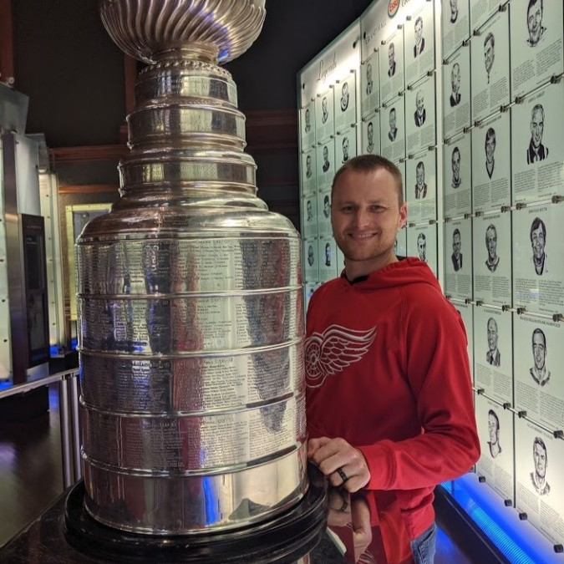
Let’s Connect!
GitHub - AndrewRathbun
X - bunsofwrath12
LinkedIn - AndrewRathbun
https://discord.gg/digitalforensics

